Slide 1
Group 16 Obscure Sorrows
John Dorman, Lewis Wilden, River Chick, Guy Zawada, Charlie Kinglake, Roberto Mitrea

Slide 2

Target Audience
Males Aged 16-28
Element of time constraints

Slide 3
Onism
Occhiolism
The frustration of being stuck in just one body that inhabits only one place at a time.
As the game progresses, the player must switch between the two characters more often.
The awareness of the smallness of your perspective.
The Level will be filled with fog , the level is only visible when using a light source.

Slide 4
Game Mechanics
Collecting Items
Twitch Movement
Avoiding Obstacles
Puzzle Solving
Switching Between Characters

Slide 5
Game Scope
Levels
Level 1
Level 2
Level 3
Level 4
Level 5
Learn, practise, master loop

Slide 6

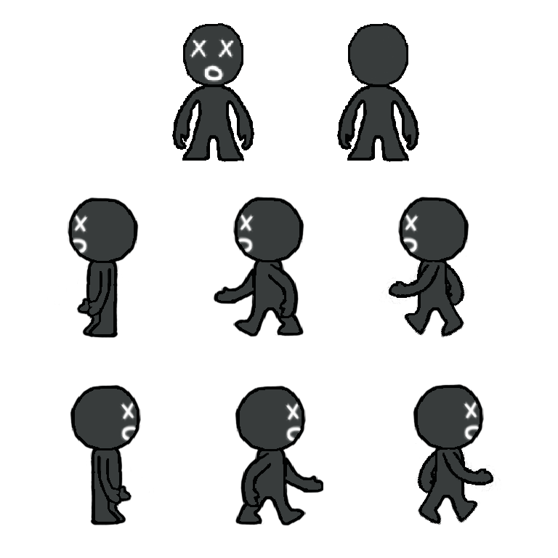
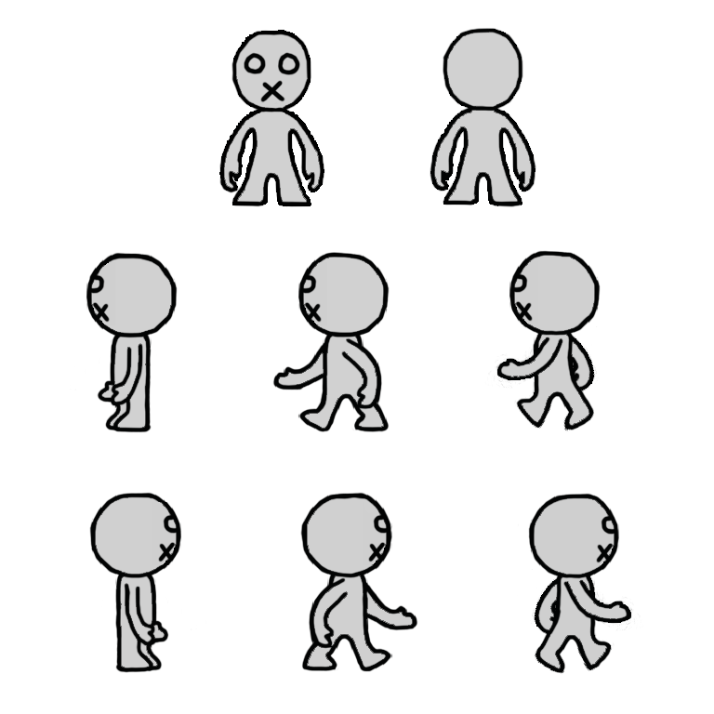
Character Art

Slide 7
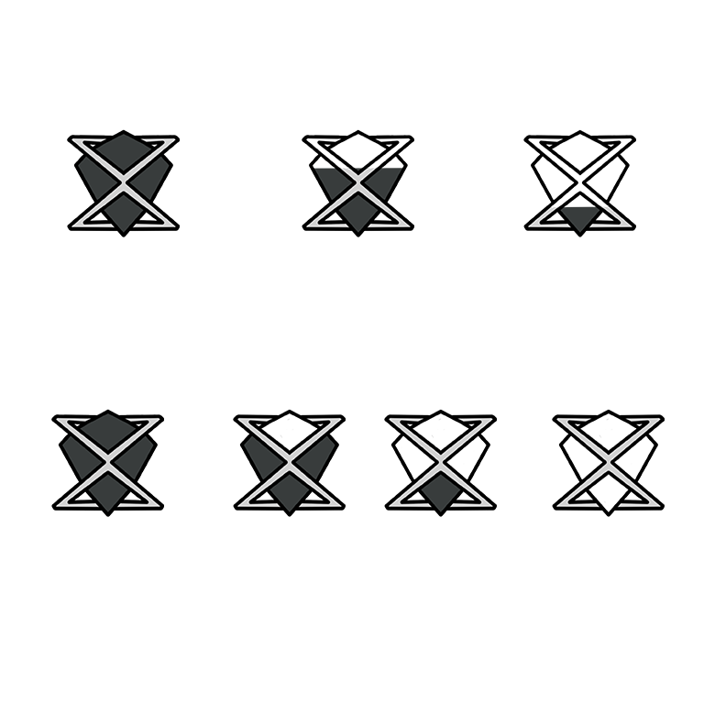
GUI Art

Slide 8
Pressure Plate & Level End Art

Slide 9


Slide 10
Game Prototype

Slide 11
What Next
Implementing Puzzles
Adding Sprites
Implement The GUI

Slide 12
Questions?

